Slide 1
Mathematical Background and Running Time Analysis
EECS 233

Slide 2
Big-O intuition
T(N) = O(f(N)) if there are positive constants c and n₀ such that
  T(N) ≤ cf(N) for all N ≥ n₀
  int sum(float[] array) {
    for (int i = 0; i <= array.length; i++)
      array[i] = array[i]*5;
    }
  int sum(float[] array) {
    for (int i = 0; i <= array.length; i++)
      array[i] = array[i]/0.2;
    }
  int sum(float[] array) {
  float[] backup = new float[array.length];
    for (int i = 0; i <= array.length; i++){
    for (int j = 0; j <= array.length; j++)
    backup[j] = array[j];
      array[i] = array[i]*5;
      if(Float.isInfinite(array[i]){
    for (int j = 0; j <= array.length; j++)
    array[j] = backup[j];
    print(“Numbers too large!”);
    break;
    }
    }
    }

Slide 3
Function Growth Rates: Mathematical Definitions.
Consider positive functions T(N) and f(N).
T(N) = O(f(N)) if there are positive constants c and n₀ such that
  T(N) ≤ cf(N) for all N ≥ n₀
  Example: 10*N²+10000 = O(N³)
T(N) = Ω(f(N)) if there are positive constants c and n₀ such that
  T(N) ≥ cf(N) for all N ≥ n₀
  Example: 0.0001*N³ = Ω(N²)
T(N) = θ(f(N)) iff T(N) = O(f(N)) and T(N) = Ω(f(N))
  Example: 0.001*N²+10000*N = θ(N²)
T(N) = o(f(N)) if for all constants c there exists an n₀ such that
  T(N) < cf(N) for all N > n₀.
or
T(N) = o(f(N)) iff T(N) = O(f(N)) and T(N) ≠ Ω(f(N))
  Example: 10*N²+10000 = o(N³)

Slide 4
How to Determine the Relative Growth Rate?
If lim_{N->∞} T(N) /f(N)
  = 0: T(N) = o(f(N)) (and O(f(N)) for sure)
  = c != 0: T(N) = Θ(f(N))
  = infinity: f(N) = o(T(N))

Slide 5
Big-O Toolbox
(for positive monotonic functions)
Constants do not matter!
  If T(N) = O(f(N) + c)) then T(N) = O(f(N))
  If T(N) = O(c*f(N)) then T(N) = O(f(N))
  If T(N) +c = O(f(N)) then T(N) = O(f(N))
  If T(N)*c = O(f(N) then T(N) = O(f(N))
Algebraic properties:
  If T1(N) = O(f(N)) and T2(N) = O(g(N)) then T1(N)+T2(N) = O(f(N) + g(N))
  If T1(N) = O(f(N)) and T2(N) = O(g(N)) then T1(N)*T2(N) = O(f(N) * g(N))
  If T1(N) = O(f(N)) and g(x) is monotonic, then g(T1(N)) = O(g(f(N))
Dominated terms do not matter:
  If T(N) = O(f(N) + g(N)) and g(N) = o(f(N)) then T(N) = O(f(N))

Slide 6
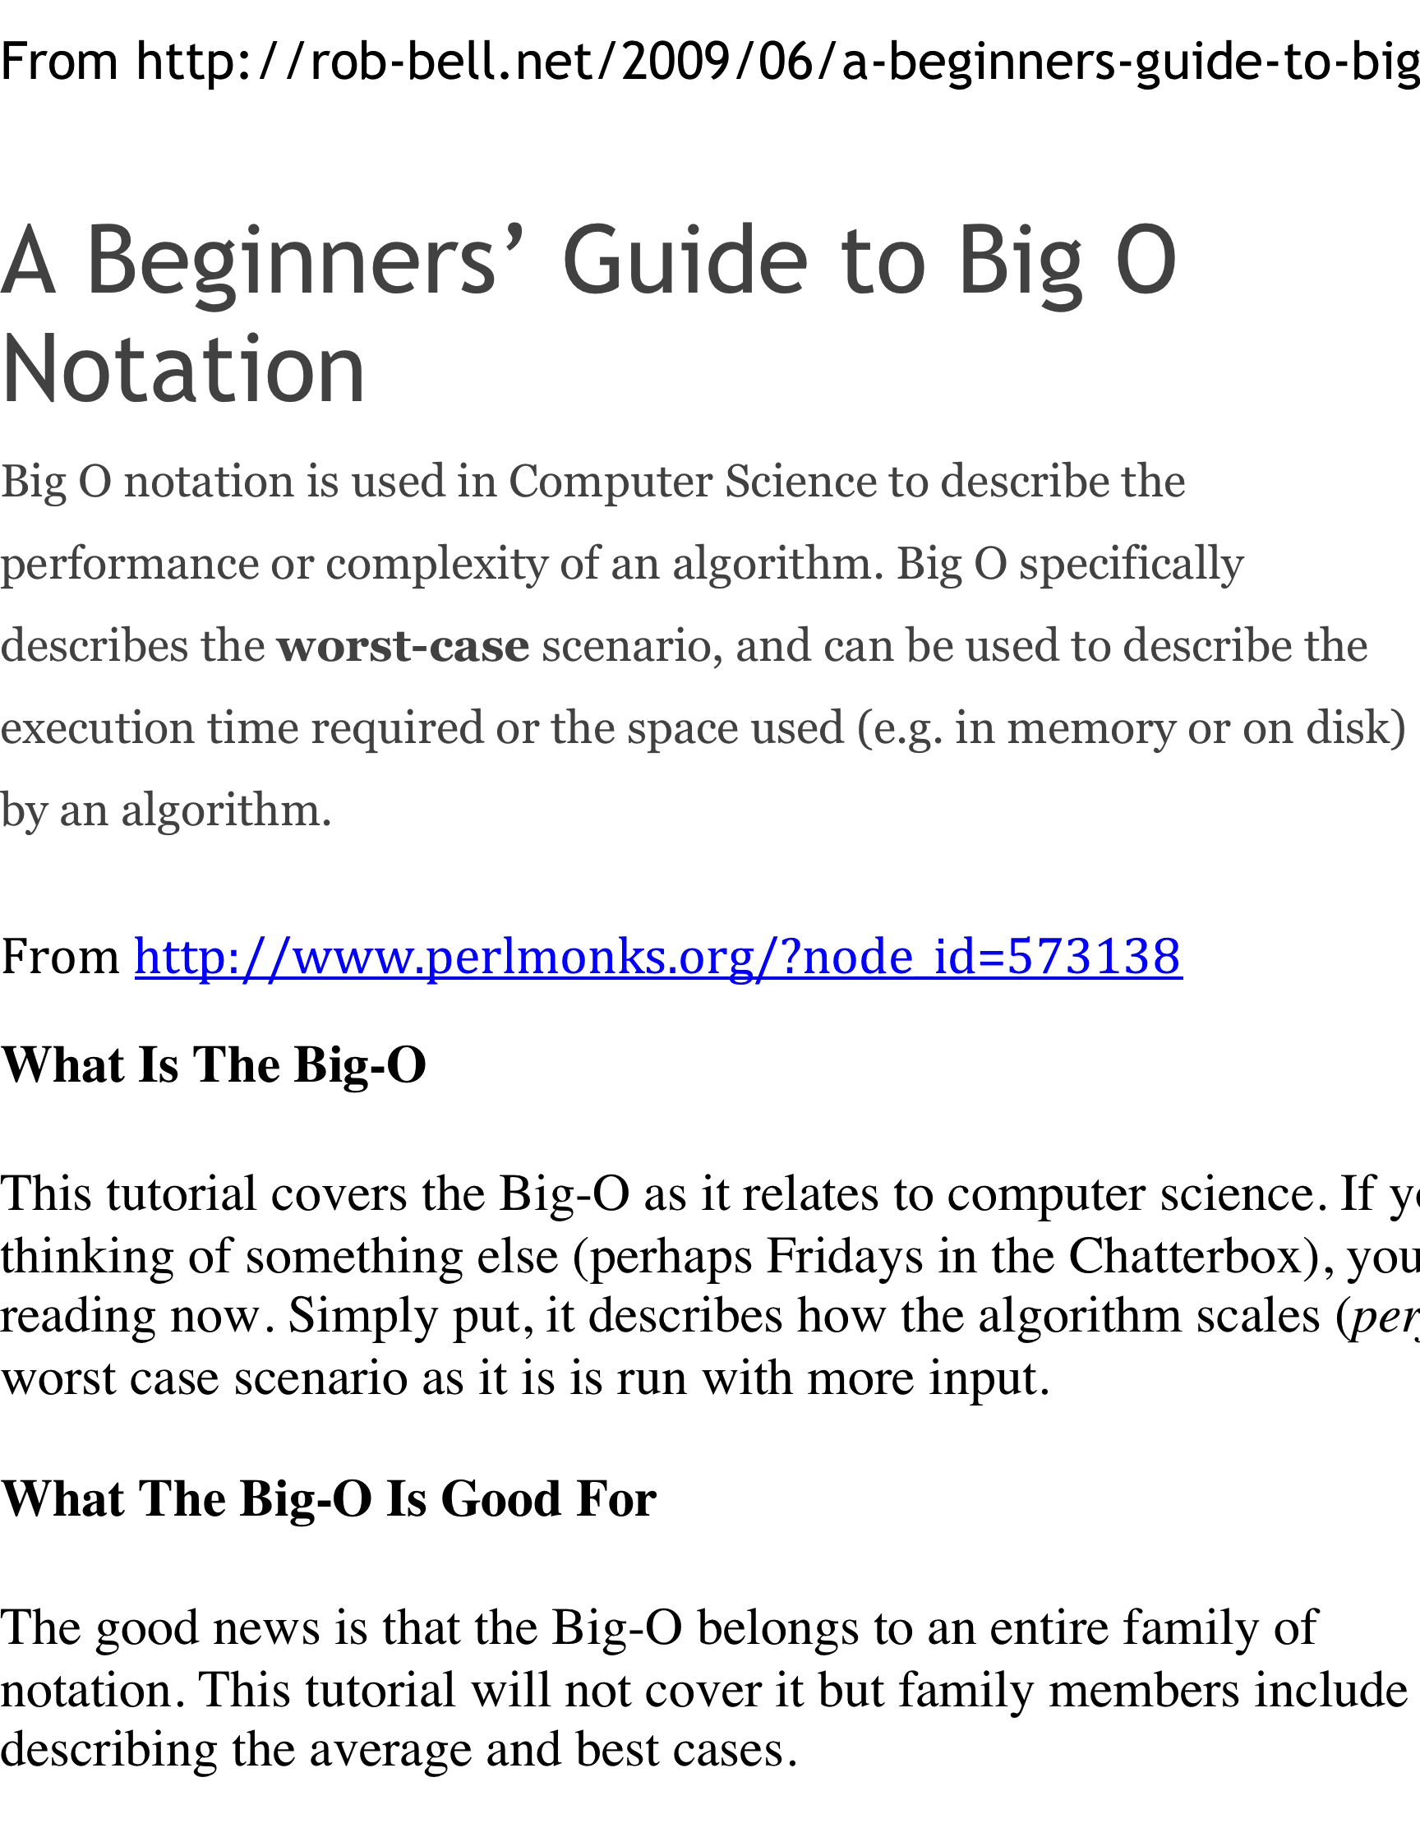
Misconceptions
From http://www.perlmonks.org/?node_id=227909
An informal introduction to O(N) notation
Quite often, when an algorithm's growth rate is characterized by some mix of orders, the dominant order is shown, and the rest are dropped. O(N²) might really mean O(N² + N).

Slide 7

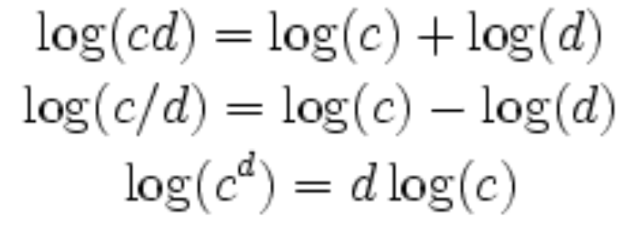
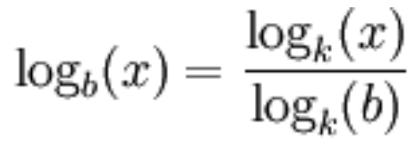
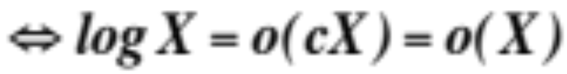
Logarithm Properties
Non-negative, monotonic function for N ≥ 1
Sub linear growth:
Basic equivalencies:
Corollary: logarithm grows slower than any polynomial!

Slide 8
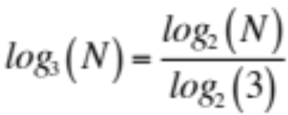
Relative Growth Rates
Examples (which grows faster?)
  1000000 versus 0.01*sqrt(N)
  log(N) versus sqrt(N)
  Nlog(N) versus N^{1.001}
  N³ versus 10000*N²
  log²(N) versus 10*log(N⁵)
  2*log₂(N) versus log₃(N)
  N*2^{N} versus 3^{N}
N^{1.001}= N* N^{0.001}
10*log(N⁵) = 50*log(N)
3^{N =} 1.5^{N *}2^{N}

Slide 9
Algorithm Analysis
Models and Assumptions
  Consider rather abstract algorithm (a procedure or method)
  Ignore the details/specifics of a computer
  Assume sequential process (a sequence of instructions)
  Ignore small constant factors (e.g., differences among “primitive” instructions)
  Ignore language differences (e.g., C++ versus Java)
Average-case versus worst-case performance
  Example: finding a person in phonebook using sequential search
    Best-case?
    Worst-case?
    Average-case?

Slide 10
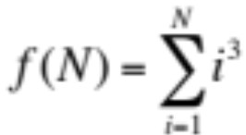
How to Calculate Running Time?
A simple example: compute
  public static int sum(int n)
  {
  int partialSum = 0;
  for (int i = 1; i <= n; i++)
  partialSum += i*i*i;
  return partialSum;
  }
Assume each operation takes unit time, total time is “around” 6N+4
Time complexity O(N)
More accurately Θ(N) in this example

Slide 11
General Rules
Simple statement: constant
  i++; i<n; etc.
Simple loops: # of iterations times the cost of the loop body
  i = 0; While (i < n) { … i++; …}
Nested loops: (the product of # of iterations of outer and inner loops) times (the cost of the inner loop body)
  for (i=0; i < n; i++)
  for(j=0; j < m; j++)
  k++;
Consecutive statements: count the more expensive one
  i = 0;
  while (i < n) { … i++; …}
  for (i=0; i < n; i++)
  for(j=0; j < n; j++)
  k++;
If/else statement: count the more expensive branch (for worst-case analysis)

Slide 12
Running time in Recursive Methods
Recursion often makes analysis more difficult.
A simple one:
  public static long factorial (int n)
  {
  if (n <= 1 )
  return 1;
  else
  return n * factorial ( n - 1 );
  }
Count the number of recursive calls (and the cost of each call)

Slide 13
Recursion – Fibonacci Example
  public static long fib( int n )
  {
  if (n <= 1)
  return 1;
  else
  return fib(n - 1) + fib(n - 2);
  }
Redundant calculation of the same Fibonacci numbers, results in exponential running time
fib(5)
fib(4)
fib(3)
fib(3)
fib(2)
fib(2)
fib(1)
fib(2)
fib(1)

Slide 14
An Example: Maximum Subsequence Sum
Given an array of (possibly negative) integers A[1…N], find the maximum sum of a sub-array A[i…j].
example: 4 5 -6 -6 2 3 5 -8 -1 4 3 7 -2

Slide 15
Algorithm 1
Cubic running time: exhaustively try all possibilities
  public static int maxSubSum1( int [ ] a )
  {
  int maxSum = 0;
  for (int i = 0; i < a.length; j++)
  for( int j = i; j < a.length; j++)
  {
  int thisSum 0;
  for ( int k = i; k <= j; k++)
  thisSum += a[k];
  if ( thisSum > maxSum )
  maxSum = thisSum;
  }
  }
Running time O(N³)
4 5 -6 -6 2 3 5 -8 -1 4 3 7 -2

Slide 16
Algorithm 2
Quadratic running time
  public static int maxSubSum2( int [] a)
  {
  int maxSum = 0;
  for( int i = 0; i < a.length; j++ )
  {
  int thisSum = 0;
  for ( int j = i; j < a.length; j++)
  {
  thisSum += a[j];
  if(thisSum > maxSum )
  maxSum = thisSum;
  }
  }
  }
Eliminate the inner loop and reduce the redundant additions
Running time O(N²)
4 5 -6 -6 2 3 5 -8 -1 4 3 7 -2

Slide 17
Algorithm 3
Linear running time
  int maxSubSum4( int [ ] a )
  {
  int maxSum = 0, thisSum = 0;
  for( int j = 0; j < a.length ); j++ )
  {
  thisSum += a[ j ];
  if( thisSum > maxSum )
  maxSum = thisSum;
  else if( thisSum < 0 ) // The first negative subsequence
  thisSum = 0;
  }
  return maxSum;
  }
  4 5 -6 -6 2 3 5 -8 -1 4 3 7 -2
The moment we find a negative subsequence – dump it and start anew from just beyond this point
  It can’t start the max subsequence
  Neither can any of its suffixes
Notes:
A suffix of a negative subsequence can’t start the max subsequence because the corresponding prefix would be positive and adding it would have only increase the max

Slide 18
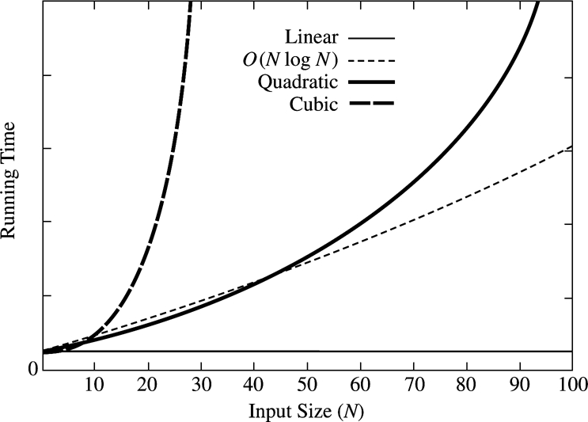
Comparison of Running Time
Four algorithms

Slide 19
Another Example: Euclid’s Algorithm
Find the Greatest Common Divisor of two positive integers (m and n)
Example: m=1989 and n=1590; remainders are 399, 393, 6, 3, 0
Logarithmic running time (O(log m)). Why?
Theorem 2.1: If M > N, then M mod N < M/2
  If N <= M/2, then since the remainder is smaller than N, the theorem is true.
  If N > M/2, then N goes into M once with a remainder M-N < M/2, proving the theorem.
  int gcd( int m, int n )
  {
  while( n != 0 )
  {
  int rem = m % n;
  m = n;
  n = rem;
  }
  return m;
  }

Slide 20
Is Your Analysis Correct?
Analysis can be complex (e.g., for recursive algorithms)
  Mistakes possible
How to verify your analysis?
  Implement the algorithm
  Measure running time
Problems:
  Constants may skew results for small inputs
  Need to test asymptotic behavior (hence need large inputs)
  Measurements usually test average time complexity; analysis usually provides worst-time complexity

Slide 21

Example: the Probability of Two Integers ( <= n) Being Relatively Prime
  public static double probRelPrim( int n )
  {
  int rel = 0, tot = 0;
  for( int i = 1; i <= n; i++ )
  for( int j = i + 1; j <= n; j++ )
  {
  tot++;
  if ( gcd( i, j ) == 1 )
  rel++;
  }
  return (double) rel / tot;
  }
Time complexity:

Slide 22
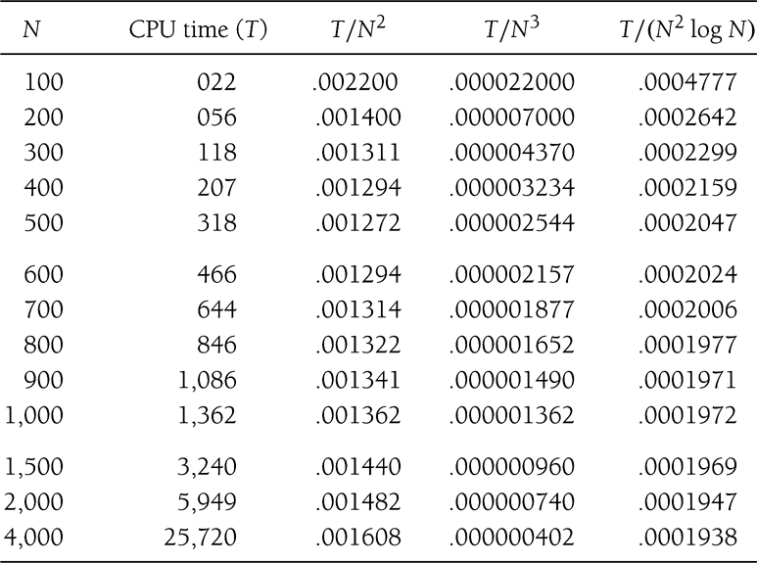

Slide 23
Etc.
Assignment #1
  Basics of object-oriented programming, algorithm analysis, recursion
  Please submit electronically

